Slide 1
Nov 2015
Sum 2015
Specimen Paper 2016

Slide 2
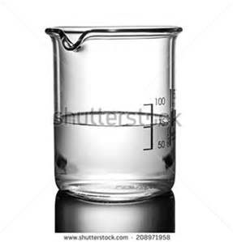
2015 Nov 11
Students are investigating the behaviour of a colourless liquid in a beaker. As the colourless liquid heats up, it becomes cloudy.
Name two sensors that would be connected to a computer in such an experiment.
Temperature
Light
Describe how the student would set up the equipment in the experiment and how the computer would monitor and present the change in readings produced by the experiment.
Light source placed one side of/outside the beaker
Light sensor placed other side of/inside the beaker
Temperature sensor placed inside the beaker
Sensors connected to the ADC/computer
Heat source placed below beaker until colour change occurs
The sensors feed back data to microprocessor/computer
Data is converted from Analogue to Digital
Readings are printed out/displayed/ Graphs are automatically produced by computer…
...light plotted against temperature/time

Slide 3
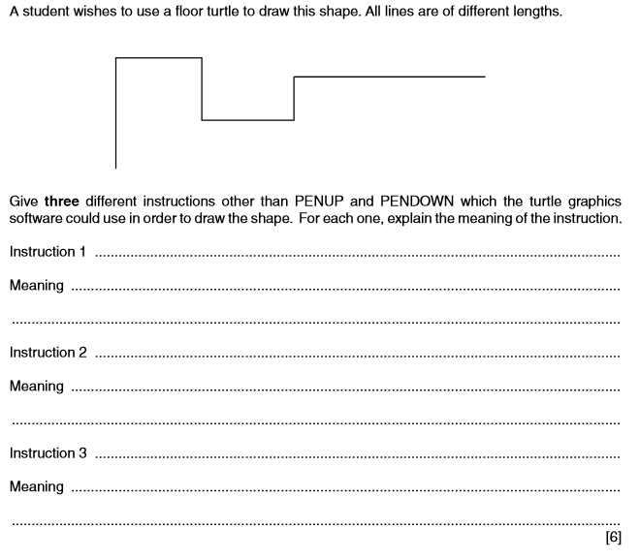
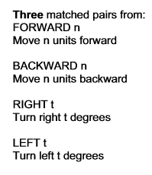
2015 Nov 11

Slide 4
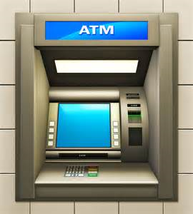
2015 Nov 11
A bank customer wishes to withdraw cash from an ATM.
Describe the computer processing which takes place in the ATM device itself.
The customer is asked to type in their PIN
The ATM checks to see if the card is valid/in date/stolen
The customer is asked which language/currency they require
The bank account details are read from the chip
Customer is asked if they want a receipt
The typed PIN number is compared with that stored in the chip
If they are the same the transaction proceeds
If they are not the same the customer is asked to re-enter PIN
If three failed attempts transaction rejected and card withheld
The customer is asked which service is required
The customer is asked how much money they want to withdraw
The amount is checked against the card limit
If transaction is authorised, transaction is completed/if transaction is not authorised, transaction is rejected

Slide 5
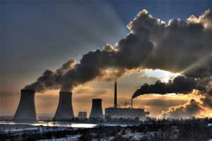
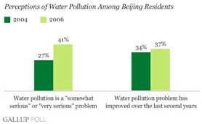
2015 Nov 12
Scientists want to find the level of pollution in a river running past a chemical factory. They will use sensors connected to a computer to do this.
Name three sensors that the scientists would place in the river.
Temperature sensor, Light sensor , pH sensor, O 2 sensor , CO2 sensor
Explain why it is so important to carefully consider the position of sensors placed in the river.
Need to know values in unpolluted part of river
Need to know values in polluted part of river
Need to place sensors in river above factory
Need to place sensors in river below factory
Describe how the computer would monitor the level of pollution in the river.
The sensors feed back/send data to microprocessor
Data is converted from Analogue to Digital/sent through an ADC
Readings from above the factory are compared with those from below factory
Differences/results are printed out
Graphs are automatically produced by computer showing values from below and above factory… ...plotted against time

Slide 6
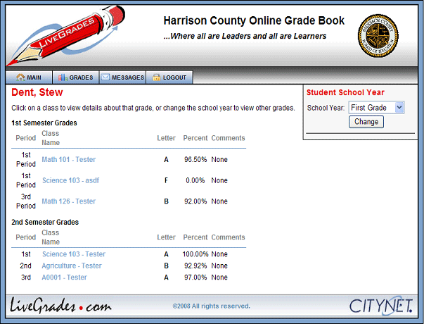
2015 Nov 12
A school has introduced a system so that parents of its students can access data about their children.
(a) Give three reasons why the school has introduced this system.
To save printing costs of reports
To ensure test results, etc. are received by parents
To allow immediate feedback to parents after tests/exams
To keep parents up to date with child’s progress/targets

Slide 7
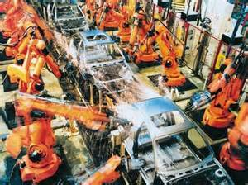
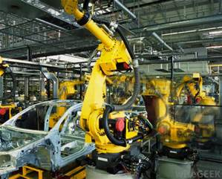
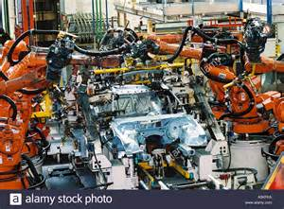
2015 Nov 12
Give three specific examples of work that are carried out by a robot in the car industry.
Putting wheels on cars
Painting car bodies
Welding parts on a car body
Carrying car windscreens/doors
Moving goods in an automatic warehouse
Placing engine block into body
Installing transmission system

Slide 8
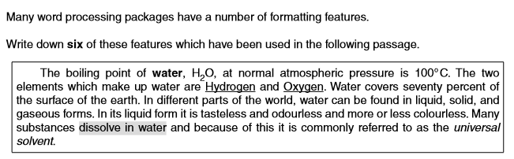
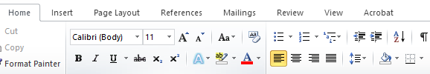
2015 Nov 13
Indent
Bold Subscript
Superscript
Underline
Text highlight
Italic
Fully justified
Border

Slide 9
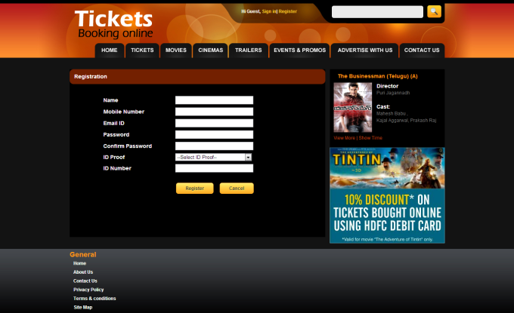
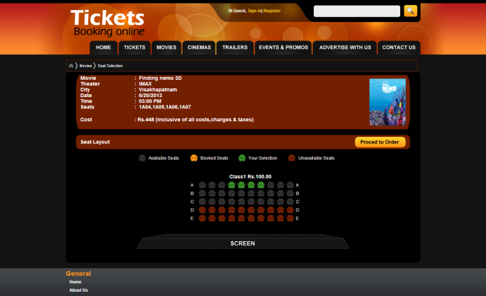
2015 Nov 13
Give three reasons why it would not be sensible to use batch processing in an online theatre booking system.
It might lead to double booking
Customer would not be sure booking has been successful
Would take a long time to receive confirmation/ticket
Processing would take a long time which would cost company money

Slide 10
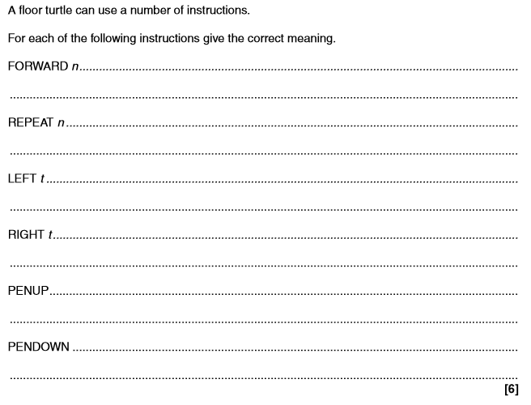
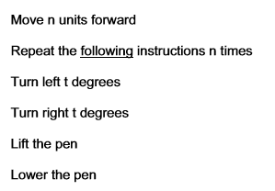
2015 Nov 13

Slide 11
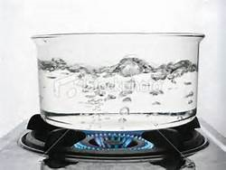
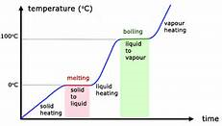
2015 Nov 13
A chemistry student wants to measure how quickly a liquid cools after it has boiled. She will use a sensor connected to a computer to do this.
Identify two variables which will need to be recorded.
Temperature
Time
Describe how the computer would process the data into a form the student could use to analyse the results
The sensor feeds back data to computer
Data is converted from Analogue to Digital
Readings are stored in a spreadsheet/software package
Graphs are automatically produced by computer… ...plotted against time
Calculations performed on spreadsheet to show rate of cooling
Graphs examined to see general overview of rate of cooling

Slide 12
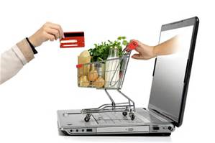
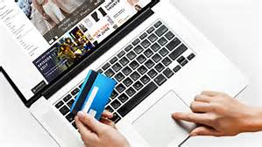

2015 Nov 13
Most supermarkets now operate online shopping.
Discuss the advantages and disadvantages to supermarkets of this development.
Initial cost of hardware/software is expensive
Fewer staff needed – less spent on wages
Fewer shops needed – less spent on rates/rent/utilities
Potentially larger customer base
Need to retrain staff Less customer loyalty/loss of customers/more difficult to sell other services/products due to lack of personal touch
Costs of system maintenance
Greater costs due to more delivery staff/vans

Slide 13
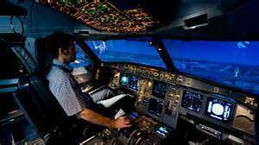
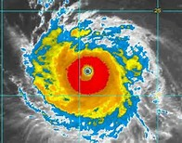
2015 Nov 13
Financial models and scientific experiments are examples of different types of modelling applications.
Give three other examples of types of modelling.
Simulations
Mathematical models
Civil engineering models
Flight/pilot simulation/training
Design of fairground rides
Traffic control
Building fire simulation
Weather forecast models
Population modelling

Slide 14
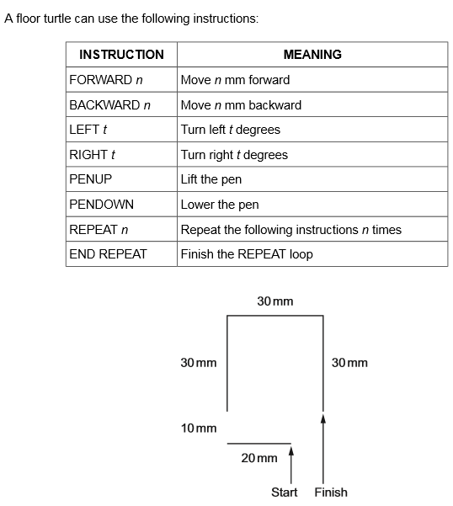
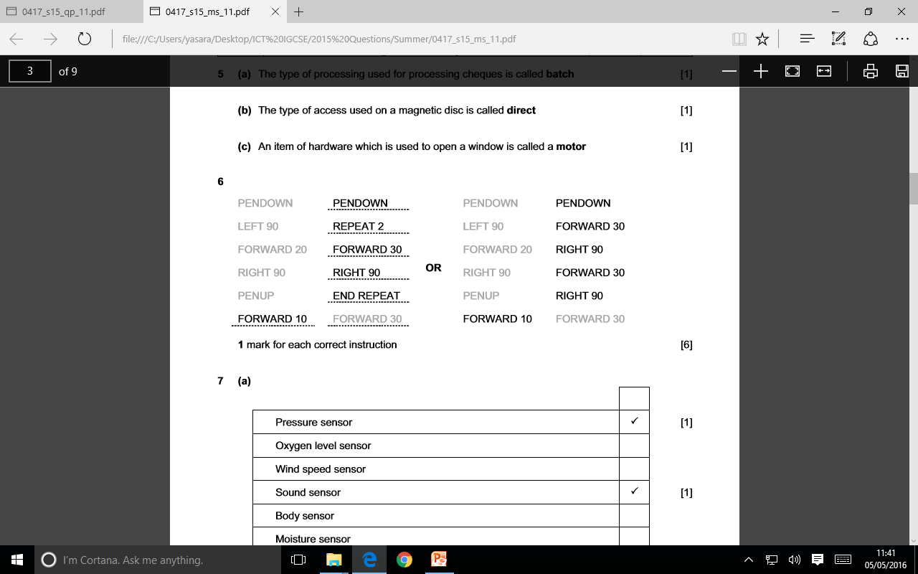
2015 Sum 11

Slide 15
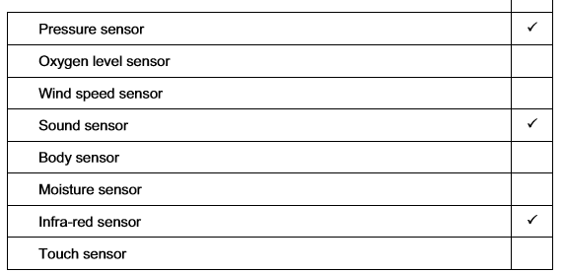
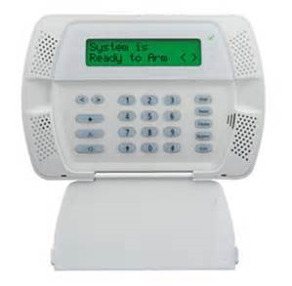
2015 Sum 11
A home is fitted with a microprocessor-controlled burglar alarm system. It is not connected to a police station.
Tick three sensors which would be used in such a system
Describe how a microprocessor-controlled burglar alarm system operates, referring to those sensors you identified in part (a)
Microprocessor checks input from the user is authentic
Microprocessor continually monitors sensors.
If infra-red sensor reading changes
If pressure greater than pre-set value...
If sound greater than pre-set value...
Microprocessor sends signal to sound alarm
Microprocessor sends signal to flashing light/house lights.
Microprocessor automatically sends message/calls/texts owner

Slide 16

2015 Sum 11
A lending library has introduced an e-book borrowing facility. Borrowers will be able to download a book to their tablet computer or e-book reader. It will automatically remove itself from the device after the loan period has expired.
Discuss the advantages and disadvantages of such a system to the library and the borrower.
Borrower:
Advantages:
Saves cost of travelling to the library
Saves time of travelling to library
More likely to be able to borrow a particular book/library has more copies
Will not be fined for going over borrowing period
Disadvantages:
Might not have finished reading book when it disappears
Have the expense of buying the correct hardware
Library:
Advantages:
Saves cost of salaries as some staff have been made redundant
Librarians will have more time to spend on other duties
Don’t have to worry about books not being returned
Disadvantages:
Will lose income from not collecting fines

Slide 17
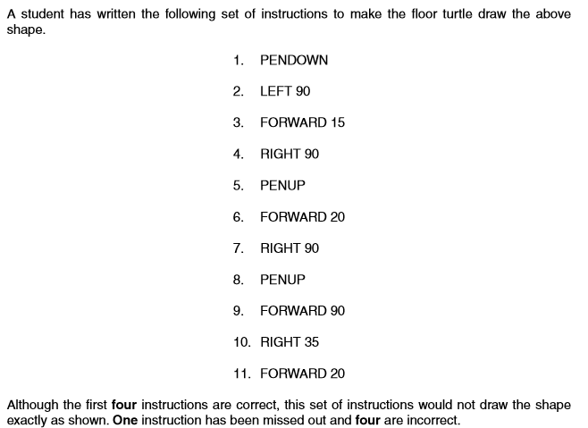
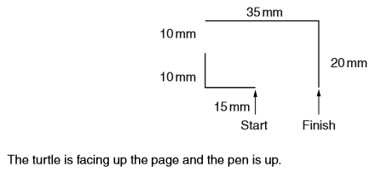
2015 Sum 12
Identify the four incorrect instructions and state the correct instructions to be used.
Missing
Forward 10
Forward 10
Pen Down
Forward 35
Right 90
Write down the missing instruction and indicate where it should be positioned in the list of instructions provided.

Slide 18
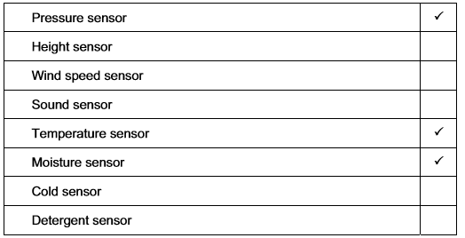
2015 Sum 12
A microprocessor controlled washing machine is fitted with a number of sensors.
(a) Tick three sensors which would be used in such a system.
Describe the actions taken by a microprocessor during a wash cycle, based on the readings from those sensors identified in part (a)
Microprocessor stores pre-set values
Reads data from sensors
Microprocessor compares readings with pre-set value
If temperature is at or above the pre-set value microprocessor sends a signal to turn the heater off
If temperature is below pre-set value microprocessor sends a signal to turn the heater on
At start of cycle, microprocessor sends a signal to open valve to let in water
If water level reached microprocessor sends a signal to switch off valve
If pressure is above preset value microprocessor sends a signal to sound alarm Microprocessor checks pressure reading and calculates the amount of water to use

Slide 19
2015 Sum 12
A bank has introduced a system whereby its customers will use contactless smart cards to make purchases. This method of payment involves customers holding their card close to a reader at shopping outlets and restaurants.
Discuss the advantages and disadvantages of this method of payment compared to using chip and PIN cards.
Contactless systems reduce the time taken by retailers to deal with each customer
Customers don’t need to queue for so long as contactless cards speed up the transactions/ quicker than inserting the card and entering the PIN
Only checks whether the card is not cancelled or stolen not always making a full check on what the balance of the holder’s account is.
Customers are limited in what they can buy as transactions must be below a certain value
In some cases, the customer can unwittingly pay for another customer’s purchase if they get too close to the terminal.
A thief armed with a suitable reader, within a few feet of the customer, would be able to interrogate all of the cards in their wallet without their knowledge.
If customer lost card a thief could make purchases without having to know a PIN
Customer can pay twice as terminal may detect the card for contactless payment but has inserted the card to use the PIN.
Customer doesn’t have to worry about PIN being overseen/shoulder surfed

Slide 20
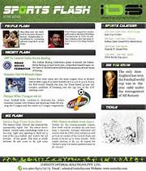
2015 Sum 12
A school in the UK holds a sports day every year. Students compete in a number of athletics events during the day.
The results of all events, together with suitable photographs, are to be included in the school newsletter on its website. Initially the results will be stored in a spreadsheet.
Describe how the sports day part of the newsletter will be produced.
Load/open web authoring package
Create tables
Take photo using digital camera/ordinary camera or video camera
Upload from camera
Save the image/video
Load webpage
Import/copy and paste/insert image into document/embed image source into markup
Position the image/resize image/edit image
Type text/import text files Edit/format text
Insert spreadsheet
Insert/copy data from spreadsheet Paste data into table Create chart from spreadsheet

Slide 21
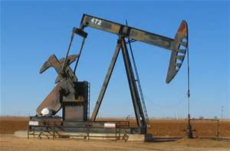
2015 Sum 12
An oil prospecting company wants to use an expert system to help it to decide where to drill for oil. Describe how such a system would work.
Uses interactive interface/interactive interface asks questions about geological profile
Answers to questions are typed in
geological profile is typed in
Further questions are asked based on previous responses
expert system analyses data
inference engine compares data… …compares data with that held in the knowledge base... ...using rules base
matches are found
Probabilities of oil being present are suggested
Depths of likely deposits are suggested
Predictions of geological strata above the deposits of oil are output
Give two different uses of expert systems for diagnosis.
Medical diagnosis
Car engine fault diagnosis
Computer fault diagnosis

Slide 22
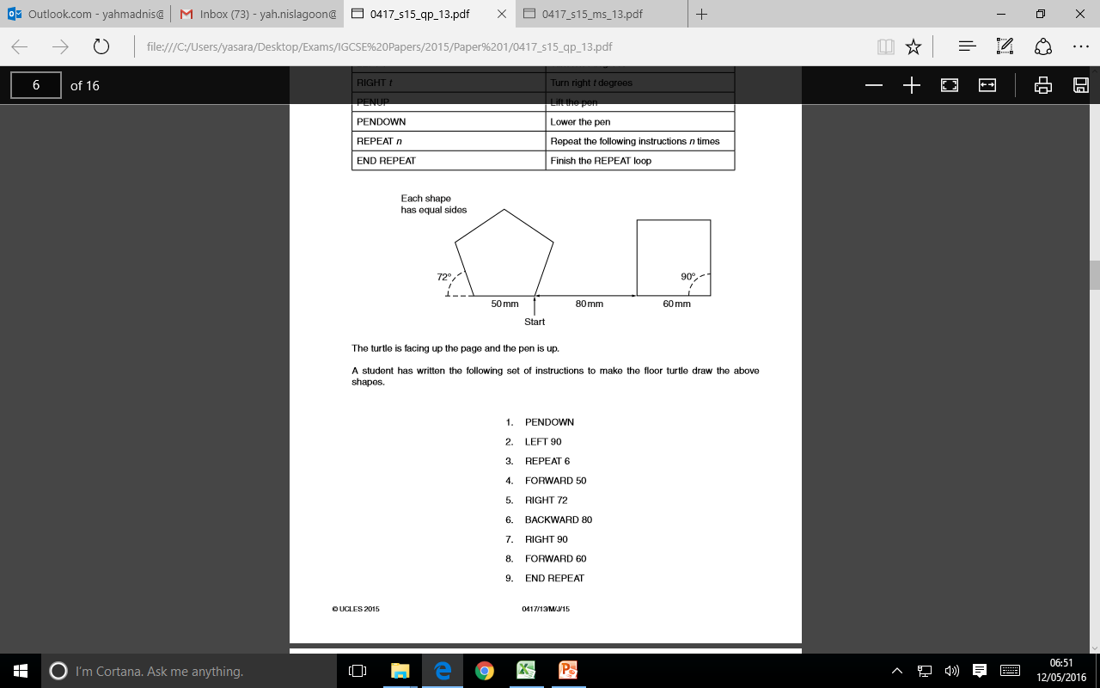
2015 Sum 13
Write down the four missing instructions and indicate where they should be positioned in the list of instructions provided.
Repeat 5
Identify the incorrect instructions and state the correct instruction to be used.
Missing END REPEAT is missing after RIGHT 72 (5)
Missing PENUP is missing before BACKWARD 80 (6)
Missing PENDOWN is missing after BACKWARD 80 (6)
Missing REPEAT 4 is missing before RIGHT 90 (7)

Slide 23
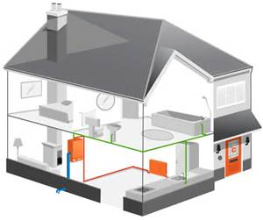
2015 Sum 13
An office has a microprocessor controlled central heating system.
Name and describe, in detail, the use of two input devices in such a system.
Number pad/touch screen/remote control
For the user to input the required temperature
Temperature sensor
To input current temperature of the room/office
Describe how the microprocessor would keep the temperature of the office at a constant 19°C.
Microprocessor receives temperature from temperature sensor
Microprocessor stores required temperature/19 as preset value
Compares temperature from sensor to pre-set temperature/19
If temperature is lower than preset value/19 microprocessor sends a signal to the actuator… …to turn heater on
If higher than preset value/19 microprocessor sends a signal to turn heater off
Wait set period of time before looping/process is continuous

Slide 24
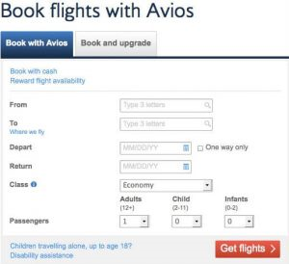
2015 Sum 13
A travel company uses an online booking system to book flights for its customers.
The travel agent will type in the departure date, departure airport and destination airport.
The system does not allow invalid airport names. Describe the processing and outputs involved in such a system.
Computer database is searched for matching departure airport
Computer database is searched for matching arrival airport
If flight on correct date found
Search if seats/tickets available
If so flags seat as booked
Reduces number of seats/tickets available by one
e-ticket details are output
e-ticket details sent by travel agent to customer
Give three other organisations which make use of online booking systems.
Theatres, Cinemas, Football clubs/stadia, Holiday booking company

Slide 25

2015 Sum 13
A head teacher has decided that the school newsletter will no longer be printed out for parents but, instead, will appear on the school website.
Name three features available on a website not available in a hard copy version of the newsletter. For each one describe how it could be used on the school website.
Sound
Spoken introduction by head/voiceover the presentation/background music/school choir/band/orchestra
Animation
Text effects/cartoon representing school activities
Video
Introduction by head/school play/choir/band/orchestra/sports activities
Hyperlinks
Move to another page in the website

Slide 26
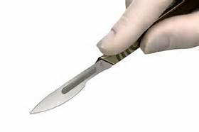
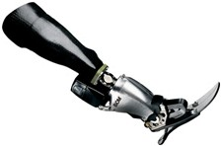
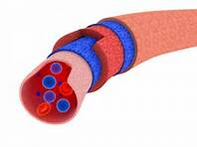
2016 Specimen
Describe three types of medical aid which can be produced using a 3D printer.
Surgical and diagnostic aids
Prosthetics and medical products,
Tissue engineering
Artificial blood vessels
Designs of medical tools and equipment

Slide 27
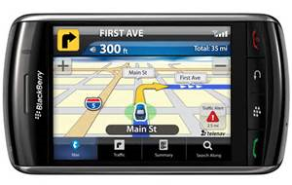
2016 Specimen
Explain what is meant by GPS.
Global Positioning System
Space-based navigation system
Typically four satellites must be visible to the receiver
Calculates the distance from a receiver to the satellite
Calculates the position of the receiver
Give two examples of the use of GPS
Used in cars to calculate routes
Used by walkers to locate position on hills/mountains
Used by runners to calculate distance run –
Used by farmers for tractor navigation/soil evaluation/livestock control/yield monitoring
Used in satellite navigation systems for ships – used in tracking aircraft

Slide 28
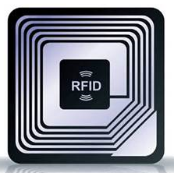
2016 Specimen
Johann is going on holiday to a different country. He will need to take his passport. He has a new type of passport which has an RFID chip in it. He will be passing through automated passport control gates.
Describe what an RFID chip consists of.
An integrated circuit…
…which contains an aerial…
…which receives and transmits data
Describe how RFID will be used as he passes through passport control.
He places his passport against the RFID reader
He stands in front of a scanner/fingerprint scanner is used
His facial characteristics/fingerprints are compared with…
…those stored on the RFID chip

Slide 29
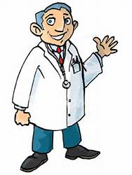
2016 Specimen
Doctors often use expert systems to diagnose illnesses of patients
Data is entered using keyboard/touch screen
Uses interactive interface/asks questions...
...based on previous responses
Inference engine compares data
Compares data with that held in the knowledge base...
...using rules base
Matches are found
System suggests probable illnesses
Give two other uses of expert systems
Car fault diagnosis
Prospecting
Tax
Careers
Chess games
Knowledge Base

